Slide 1


Wickedly Water Efficient
Lessons 1 & 2

Slide 2

Lesson 1 – Why is water important?
Learning objectives:
Understand why water is important.
Recognize that there is lots of water on Earth, but not much is freshwater.
Understand how farmers use water to produce food.
Success criteria:
Complete Waterstorm activity

Slide 3
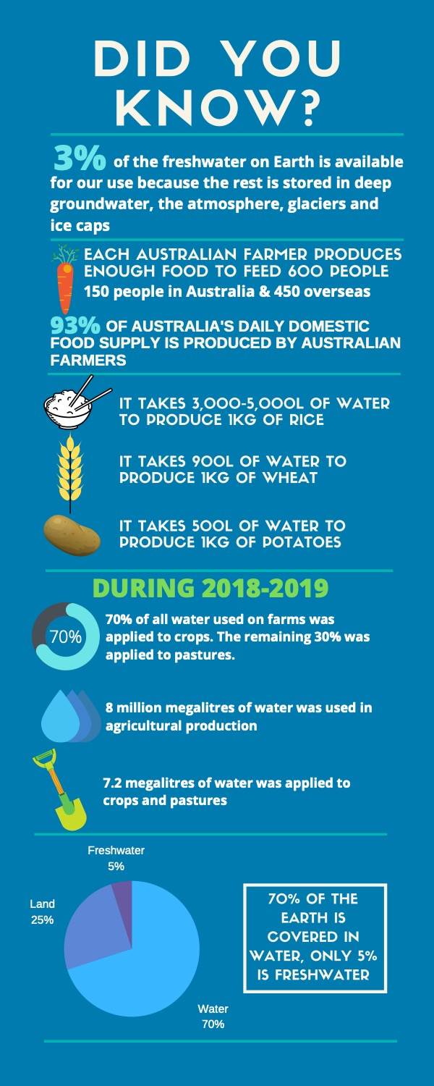
Lesson 1 - Why is water important?
Water is essential for all living things.

Slide 4
Lesson 1 - Why is water important?
What is a megalitre?
Kilolitre = 1,000 L
Megalitre = 1,000,000 L

Slide 5

Lesson 1 - Why is water important?
Look it up
What is a megalitre?
Kilolitre = 1,000 L
Megalitre = 1,000,000 L

Slide 6

How much freshwater is there?
100% of all water
on Earth

Slide 7
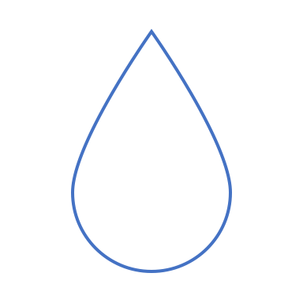

How much freshwater is there?
100% of all water
minus seawater
= only 3% freshwater

Slide 8
How much freshwater is there?
Now take away the water frozen in glaciers and polar ice caps , and you get…..

Slide 9
How much freshwater is there?
1% of water on Earth is fresh and available to drink, grow food, keep rivers and wetlands healthy….

Slide 10
Why is water important in agriculture?
Agriculture is the greatest user of water on a global scale.
69% of all freshwater extracted from the Earth resources.
Most of the foods we like to eat need more water than rainfall to grow.
Farmers need to feed a lot of people.
BUT….
More than 40% of the world’s people don’t have enough water
United Nations Sustainable Development Goal 6 = avoid the waste of water and make sure everyone has access to clean drinking water.
AND…..

Slide 11
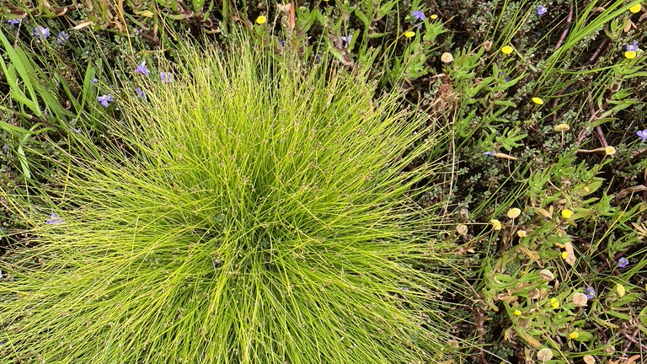
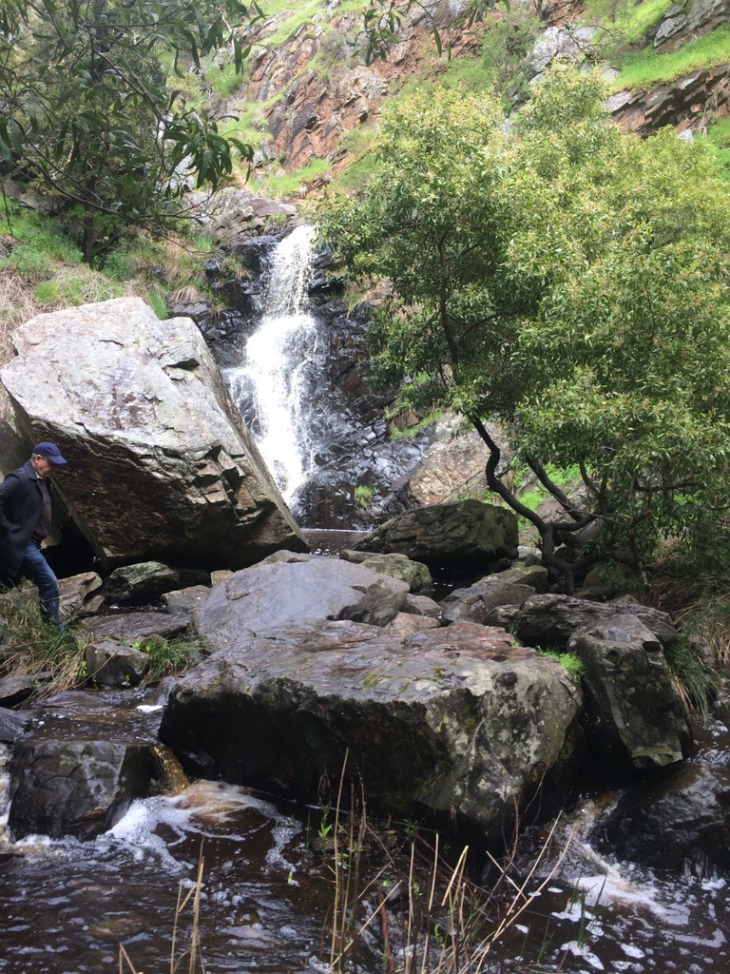
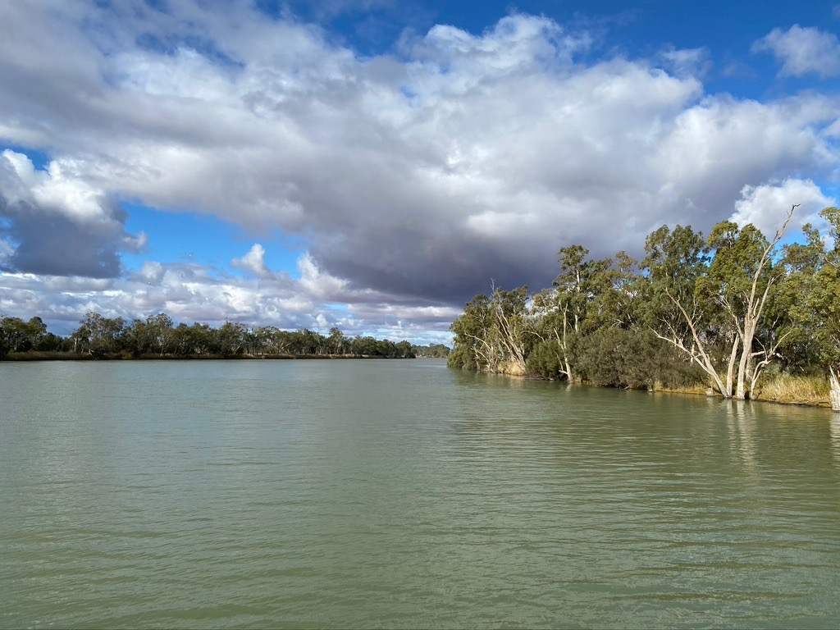

Rivers, wetlands, creeks, lakes and oceans need freshwater too!

Slide 12
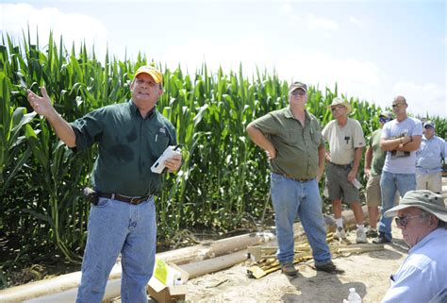
SO……
Farmers need to be wickedly water efficient!!

Slide 13
Why is water important?
Video – : https://vimeo.com/77933478

Slide 14
Water storm activity – why is water important?
Why is water important to your life?
How do you use water?
Where do we get water from?
Where does water go after we’ve used it?
How is water used in growing food?
Why do farmers need to be water efficient?
Why we need to take care of our water?
What could you do to save water?

Slide 15
Lesson 2 – Introduction to Experimental Design
Learning objective:
Plan and conduct a plant watering experiment.
Success criteria (Lessons 2, 3 and 4):
An experimental plan that includes:
  Hypothesis
  Independent variable
  Dependent Variable
  Control
  Materials
  Methods
  Safety plan

Slide 16
Lesson 2 – Introduction to experimental design
Iterative process
= go back and forth between steps as you work to test your hypothesis

Slide 17
Experimental Design
  Hypothesis – statement of what you think will happen
  Independent Variable – varied by the scientist – the “treatment”
  Dependent Variable - change that is observed/measured e.g. height (cms)
  Control – things we want to stay the same throughout the experiment
  Replicates – set up more than one of each treatment
  Randomise – mix up your replicates to control for other factors
  Materials – everything you need to conduct the experiment
  Methods – how we are going to do the experiment
  Risk assessment – safety plan

Slide 18





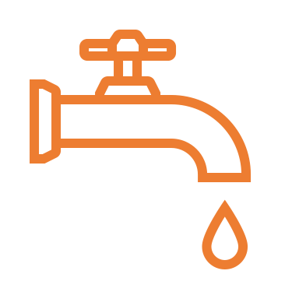



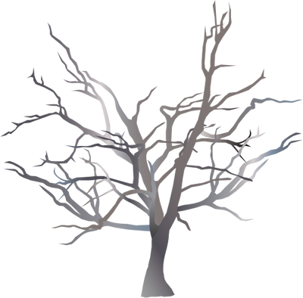


What do we know that we can use to form our hypothesis?
Water use by plants
Transpiration
CO₂
H₂O
O₂
What if there is not enough water?
What if too much water is used?
Rainfall
Plants need water to photosynthesize
Evaporation
Soil water taken
up by roots
Water not used by plants drains away

Slide 19
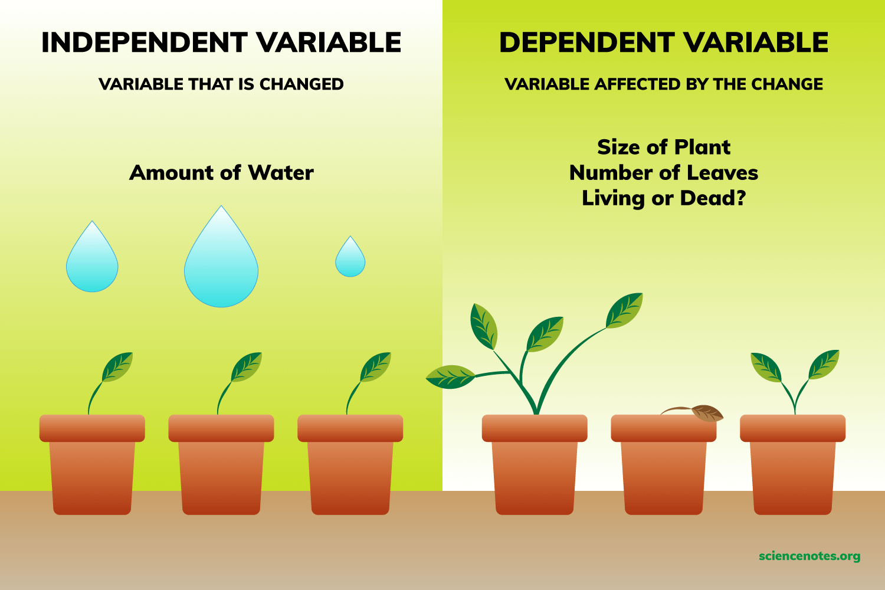
Independent and Dependent Variables
https://youtu.be/_VdOB4JJE_8

Slide 20
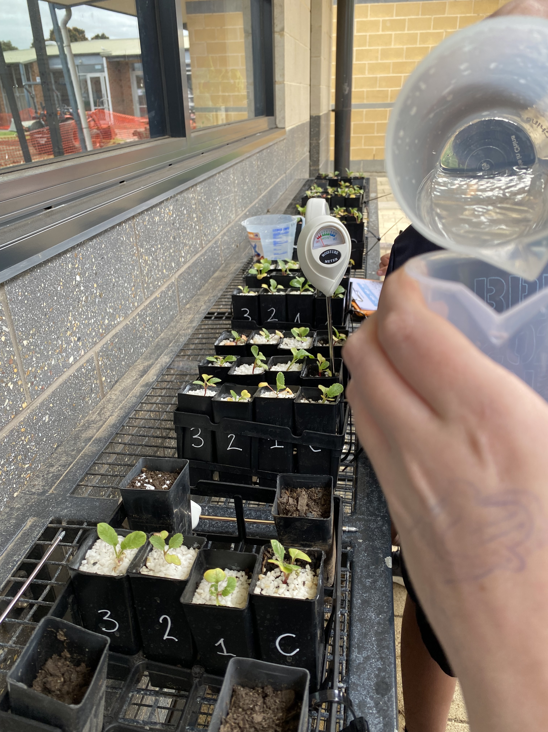
Materials and Methods

Slide 21
  Our Experiment
  Does volume of water affect plant growth?
  Dependent variable
  Measurements
  Water volume
  Moisture level
  Plant Height
  Plant width
  Control
  (water by meter)
  1 ml
  10 ml
  30 ml
  Independent variable = Varying water volume
  Water twice a week.

